Slide 1
LinkedIn Best Practices
Building your Profile and engaging in services

Slide 2
Key Takeaways
Getting the most from your profile
Resources LinkedIn offers to assist in networking and career/professional development

Slide 3
How is LinkedIn selling itself to students

Slide 4
How is LinkedIn selling itself to students
Not just for top executives
Perfect place to start your professional story
It’s your resume that never sleeps
Networking:
Alumni
Recruiters
Family/Friends
Search for jobs/Career research
Create a path from campus to career

Slide 5
How do students perceive LinkedIn?
Facebook for old people
“My dad has one of those”
They are insecure that their experience isn’t good enough
They don’t understand all LinkedIn has to offer
They haven’t heard of it

Slide 6
Resume vs. LinkedIn Profile
LinkedIn allows you to tell more of your story
You can upload presentations, publications, media, and other projects
You can add some personal touches to your profile
Your headshot, cover photo, and summary are places where you can inject some spirit that is lacking in resumes
You don’t have to submit it.
Your linkedIn profile is working for you around the clock.

Slide 7
Put together your professional profile
This is your mini elevator pitch; what people should know about you.
Say what you are
Say who you help
Say how you do it
Career Advisor who guides Indiana University students on their career journey.
50% of hiring managers will decide whether to move forward with a candidate’s application based on their LinkedIn profile

Slide 8
Put together your professional profile
A photograph ads credibility
Dress as you would for the job you’d like
Shoot in a bright location and a nice, neutral background
Headshots are preferred
Professional headshots aren’t necessary
Smile or present yourself pleasantly
Cheese is okay, cheesy isn’t.

Slide 9
Your photograph and headline often combine for your first impression.
50% of hiring managers reported that they decide whether to move forward with a candidate’s application based on their LinkedIn profile.

Slide 10
Put together your professional profile
Adding your school, degree, and major is important for many reasons:
Companies recruit from specific schools
Alumni networking
Include relevant coursework and your strong GPA
Members with a school tagged in their profile get 10x more views on average

Slide 11
Put together your professional profile
The summary is where we can personalize our profile to tie our experience, top skills, and personality together.
Good summaries include:
Goals
Skills
Trajectory
Experience
Don’t be afraid to add some personal flare. It is appropriate to include hobbies, interests, and use your personal tone of voice/writing style.

Slide 12
Put together your professional profile
Include a minimum of 5 skills learned through education or experience
Skills help recruiters find you and how you will meet their needs
Include specific keywords as well as general skiils
Think hard and soft skills
LinkedIn members with at least one skill tagged get 13x more views

Slide 13
Put together your professional profile
LinkedIn members prefer updates on industry and company news, or tips/hacks to make them better at their jobs.
LinkedIn gives generous real estate to status updates. A single status update can occupy up to 80% of the feed screen.
Job seekers with weekly status updates improve their chances of being contacted by a recruiter 10x

Slide 14
LinkedIn sends nearly 4x more people to your homepage than Facebook and Twitter
LinkedIn: 64% of social referrals to corporate homepage
Facebook: 17%
Twitter: 14%

Slide 15
Put together your professional profile
Top 4 reasons to join groups on LinkedIn
Grants access to a large network of students and professionals with similar interests
Exposes your expertise to other professionals
Help you find great content to learn from and share
Connects you with organizations
Bonus: You can message other group members without being a connection!

Slide 16
Put together your professional profile
Recommendations and endorsements give a better idea of what you’re like to work with, where your passions are, and your strongest skills.
Endorsements are a vote of confidence from someone who knows your skills.
Solicit these from people who:
You have a professional relationship
Have a grasp on your knowledge, skills, and abilities
Can attest to specific accomplishments

Slide 17
Don’t be shy to ask for an endorsement from someone you know well and respect.
Be sure to acknowledge the skills (endorse) and accomplishments (Recommend) your peers. They just might reciprocate

Slide 18
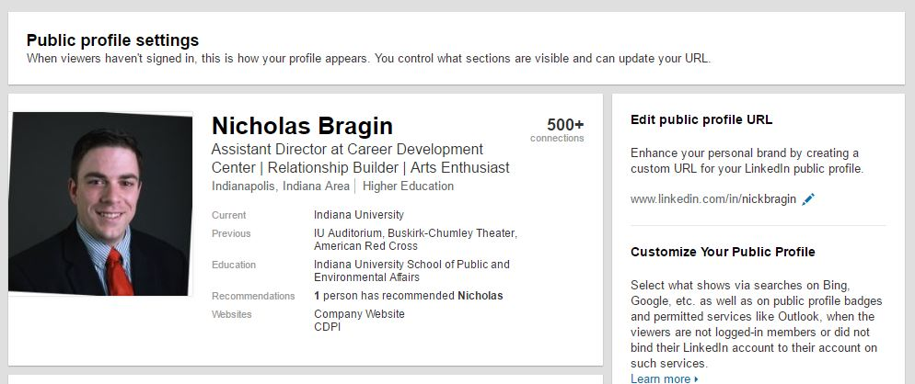
Put together your professional profile
Notes:
Makes you easier to find
You’re detail-oriented.
You’re technologically savvy.
You are a person to be taken seriously.
You appreciate the power of perception.
You understand that the little things matter.
You make an effort to present your best self.
It has a cleaner look that you can easily include on your resume, your email signature, or your business cards.

Slide 19
Put together your professional profile
Just like a resume, your experience is one of the most relevant sections that people will view.
Bullet points with accomplishment statements is the preferred format.
What to include:
Full-time employment
Internships
Part-time or summer jobs
Volunteering
1/5 hiring managers reported hiring a candidate based on volunteer experience

Slide 20
Put together your professional profile
Include projects and publications to help others assess your future work output.
Class assignments
Extracurricular output
Freelance work
Personal projects
1/3 hiring managers reported interest in seeing hobbies, extracurricular interests, and other projects.

Slide 21
Your opportunity to showcase everything that doesn’t fit on your resume.
75% of hiring managers reported looking at LinkedIn profiles to learn more about a candidate’s background.

Slide 22
Tools
Find Alumni
Groups
Company Pages
Job Search

Slide 23
Tools

Slide 24
“Your network is your net worth, when it comes to getting a foot in the door. Having third-party credibility is critical to improving your odds of getting an interview.”
- J.T. O’Donnell, career strategist, syndicated columnist and author.

